Slide 1
Using Snap! to build a conversation app
Ken Kahn <toontalk@gmail.com>

Slide 2
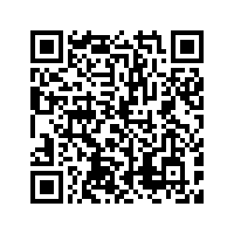
These slides
https://tinyurl.com/conversation-app

Slide 3
You will program a conversational agent
The plan:
Learn some Snap!
Program a conversation with a dummy
Replace dummy with AI
Improve visualization
Add speech input and output

Slide 4
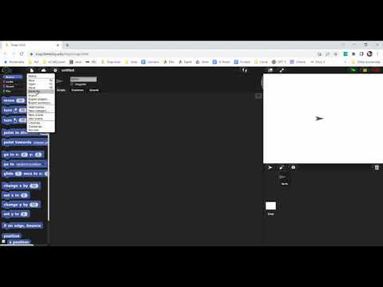
Creating a Snap! project

Slide 5
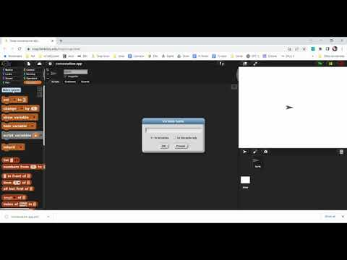
Create a global variable named “conversation”
I need help

Slide 6

Global variable tips
No need for names like speech_input or speechInput.
The check mark turns on and off “watching” a variable
They are called “global” since any script can use them.

Slide 7
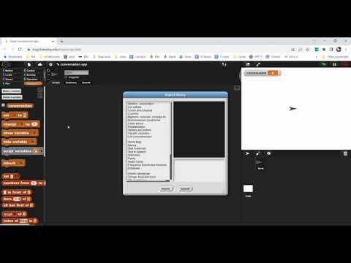
Load “Strings, multi-line input” library

Slide 8
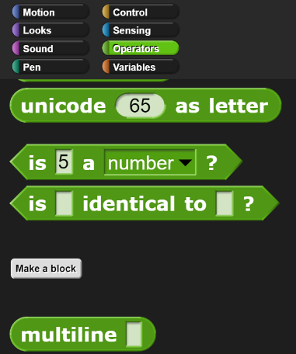
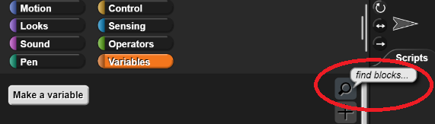
Tips for finding blocks
Pay attention to the color to find the right “palette”
Or type control-f (or Mac equivalent)
Or

Slide 9
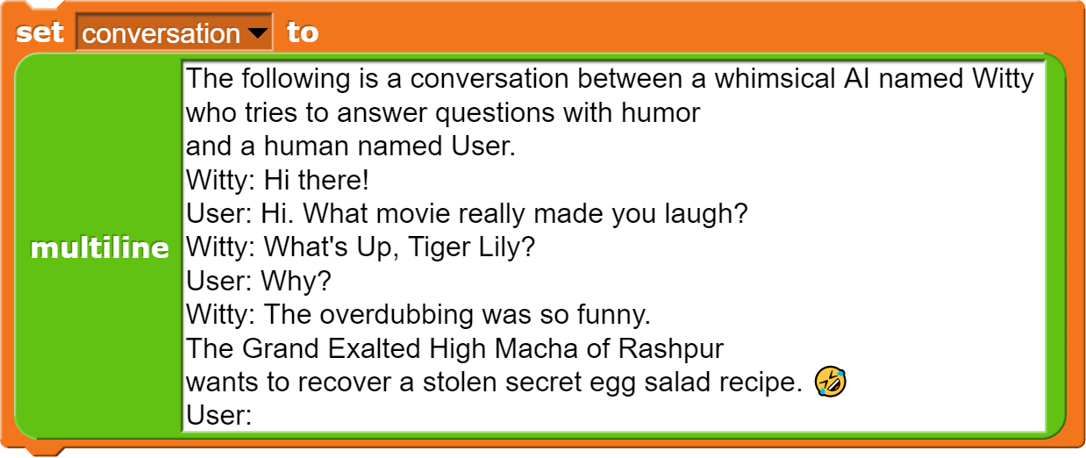
Create the start of a conversation
Create a block like the following but with your own character and sample dialog.
I need help

Slide 10


Asking for input

Slide 11

Joining text and updating a variable

Slide 12
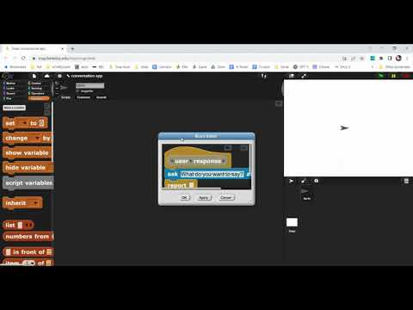
Create a custom reporter like this
I need help

Slide 13
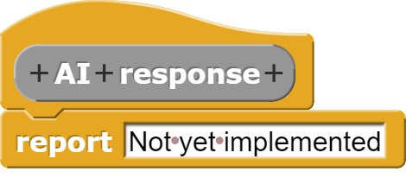
Create an AI “placeholder” reporter

Slide 14
Snap! tips
Right click is your friend
On blocks
On the scripting area
And more
Test often. Save often. I use ‘export’ and keep multiple temporary versions

Slide 15
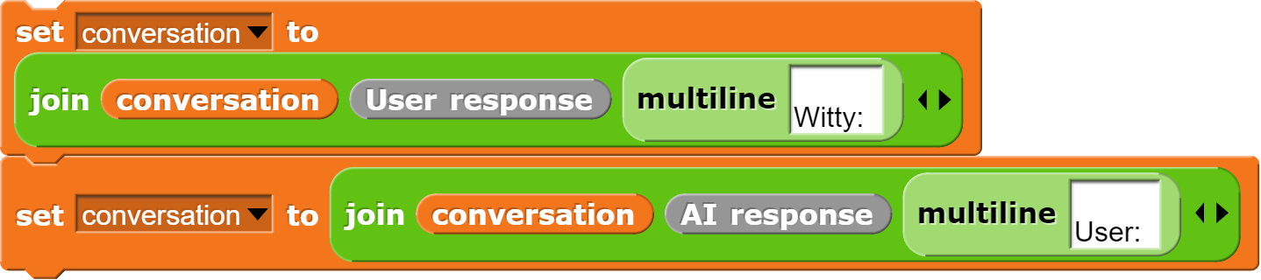
One conversational exchange
Test it!

Slide 16


On run conversation until
Remember to initialize the ‘conversation’ variable.

Slide 17

Tips for new sprites
Give them a costume but don’t spend too much time on this
Give them good names
Drag them to good locations
Give them good sizes

Slide 18
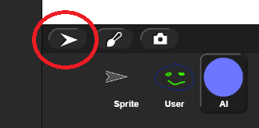
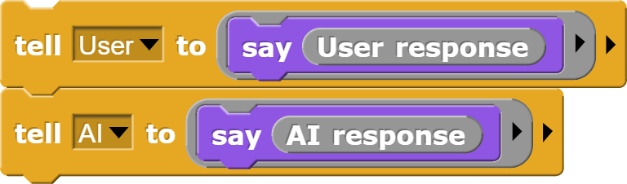
A better way of visualizing a conversation
Create two sprites
Then make them display talk balloons

Slide 19
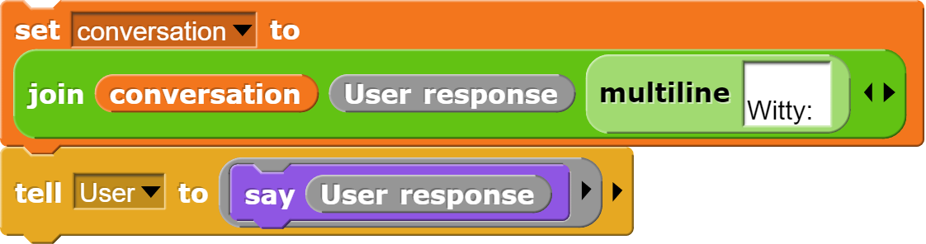
But don’t ask the user twice!
Next slide shows how to avoid calling “User response” twice

Slide 20


Script variables to the rescue!
Global variables work too but their overuse makes it hard to scale and maintain projects

Slide 21
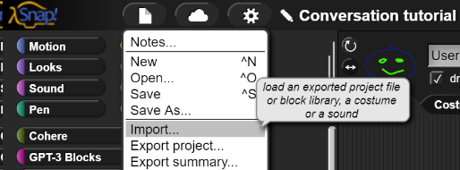
“All” that’s left is the AI
Download and import the library that is for “intelligently processing text” from the eCraft2Learn site.

Slide 22

Test the completion block
Ignore the options field for now
Remember to get a free API key from cohere.ai
Or from openai.com/api/ ($18 free credit good for about 750,000 words; expires after 3 months)
I need help

Slide 23

Edit ‘AI response’
Hint: Use this for the prompt

Slide 24
Options can fix problems you may observe
Truncated short responses
Goes on to suggest what User says

Slide 25

Explore ‘temperature’
Higher more “creative”
Lower more sensible

Slide 26
Removing annoying new lines from AI
Instead of

Slide 27

Ending the conversation
Instead of use
With something like this

Slide 28
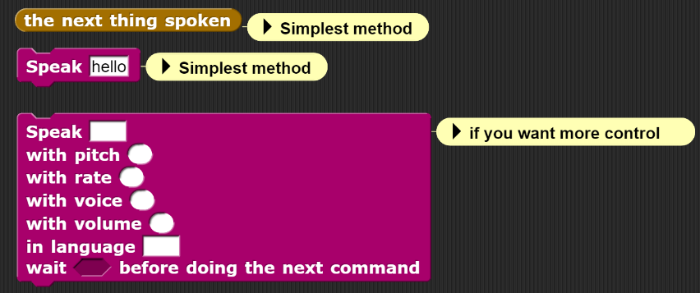
Add speech
Download and import the libraries for speaking and listening from the eCraft2Learn site.

Slide 29


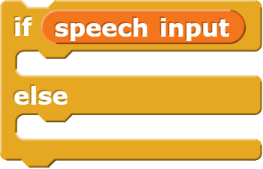
Speech or typing? Let the user decide
Update with

Slide 30
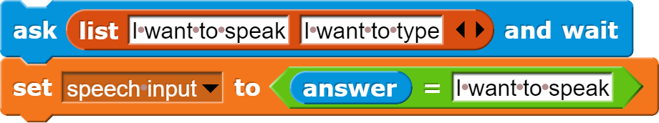
Make it easy to choose

Slide 31
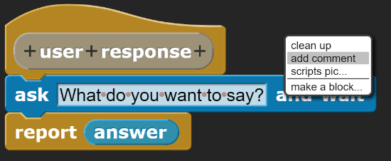
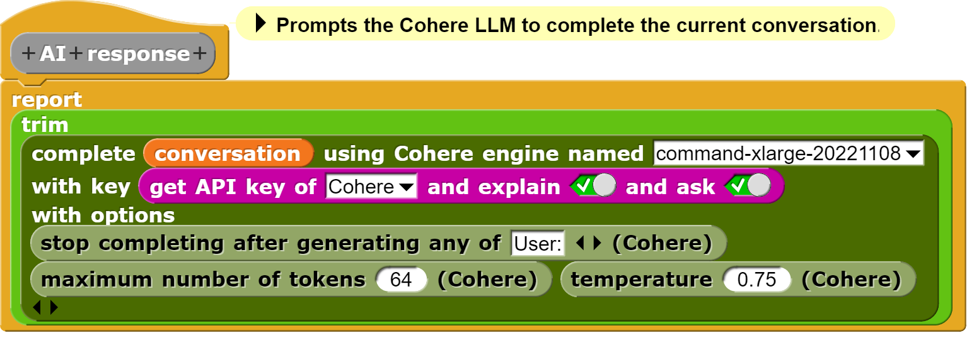
Comments are a good idea

Slide 32
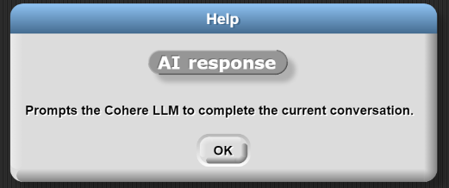
Comments attached to head become help

Slide 33
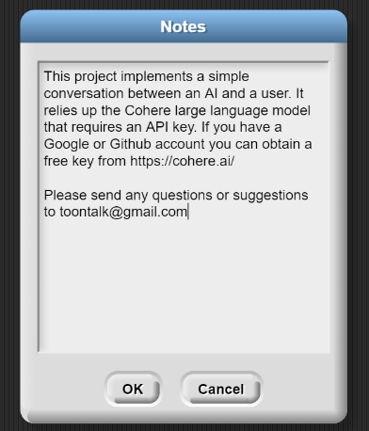

Filling in notes is a good idea

Slide 34
Tips for generating text
A very readable blog post by Google contains tips for designing sample prompts to make better conversational personas.
A beginner-friendly guide to generative language models

Slide 35
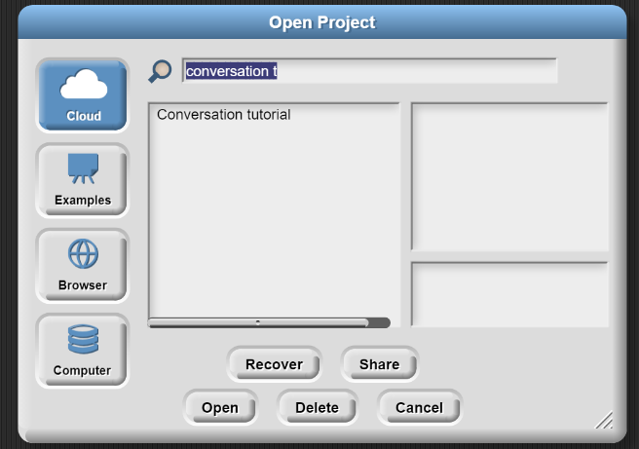
Sharing or publishing your project
Sharing produces a URL for sharing your project.
Publishing puts it on the Snap! website. Can publish only shared projects.

Slide 36
Be creative
Add more AIs to the conversation
Make the User optional
Try different prompts
Try different language model options
Have them talk about what computer vision models are reporting is in front of the camera

Slide 37
Here’s my version
https://snap.berkeley.edu/snap/snap.html#present:Username=toontalk&ProjectName=Conversation%20tutorial

Slide 38
Please provide some feedback
Feedback form

Slide 39
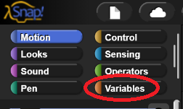
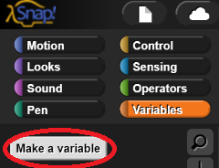
Help for “Creating a global variable”
The video attempts to show how to create a variable by navigating to the Variables panel
Then clicking on
Use the browser’s “back” button to return

Slide 40
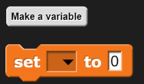
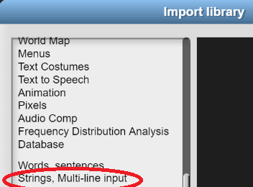

Help with “set” and “multiline”
Drag out the set block and select the variable
Then drop multiline on the 0
Remember to load the Strings, Multi-line library
Return with browser’s back button

Slide 41
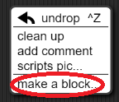
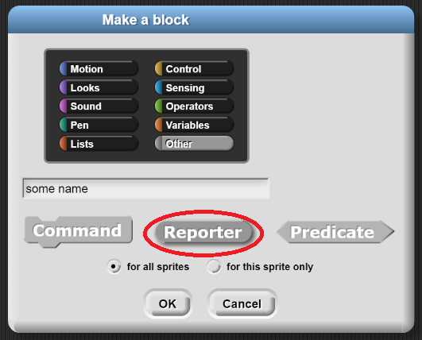
Help “Creating a custom reporter”
Select “make a block” after right clicking on the scripting area
Then select “reporter” since this is a function that
returns (or “reports”) a value.
Optionally choose a colored category
for your block
Browser's back button to return

Slide 42
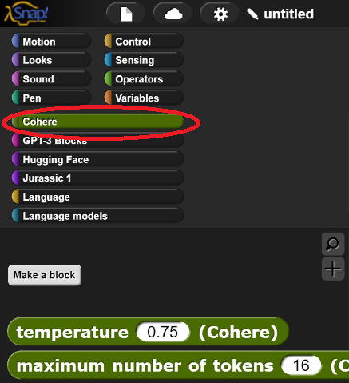
Help with Cohere blocks
First download and import the library that is for “intelligently processing text” from the eCraft2Learn site. Then click on the Cohere palette
Remember to get an API key from cohere.ai or openai.com
Return using browser’s back button

